Slide 1
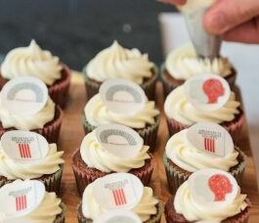
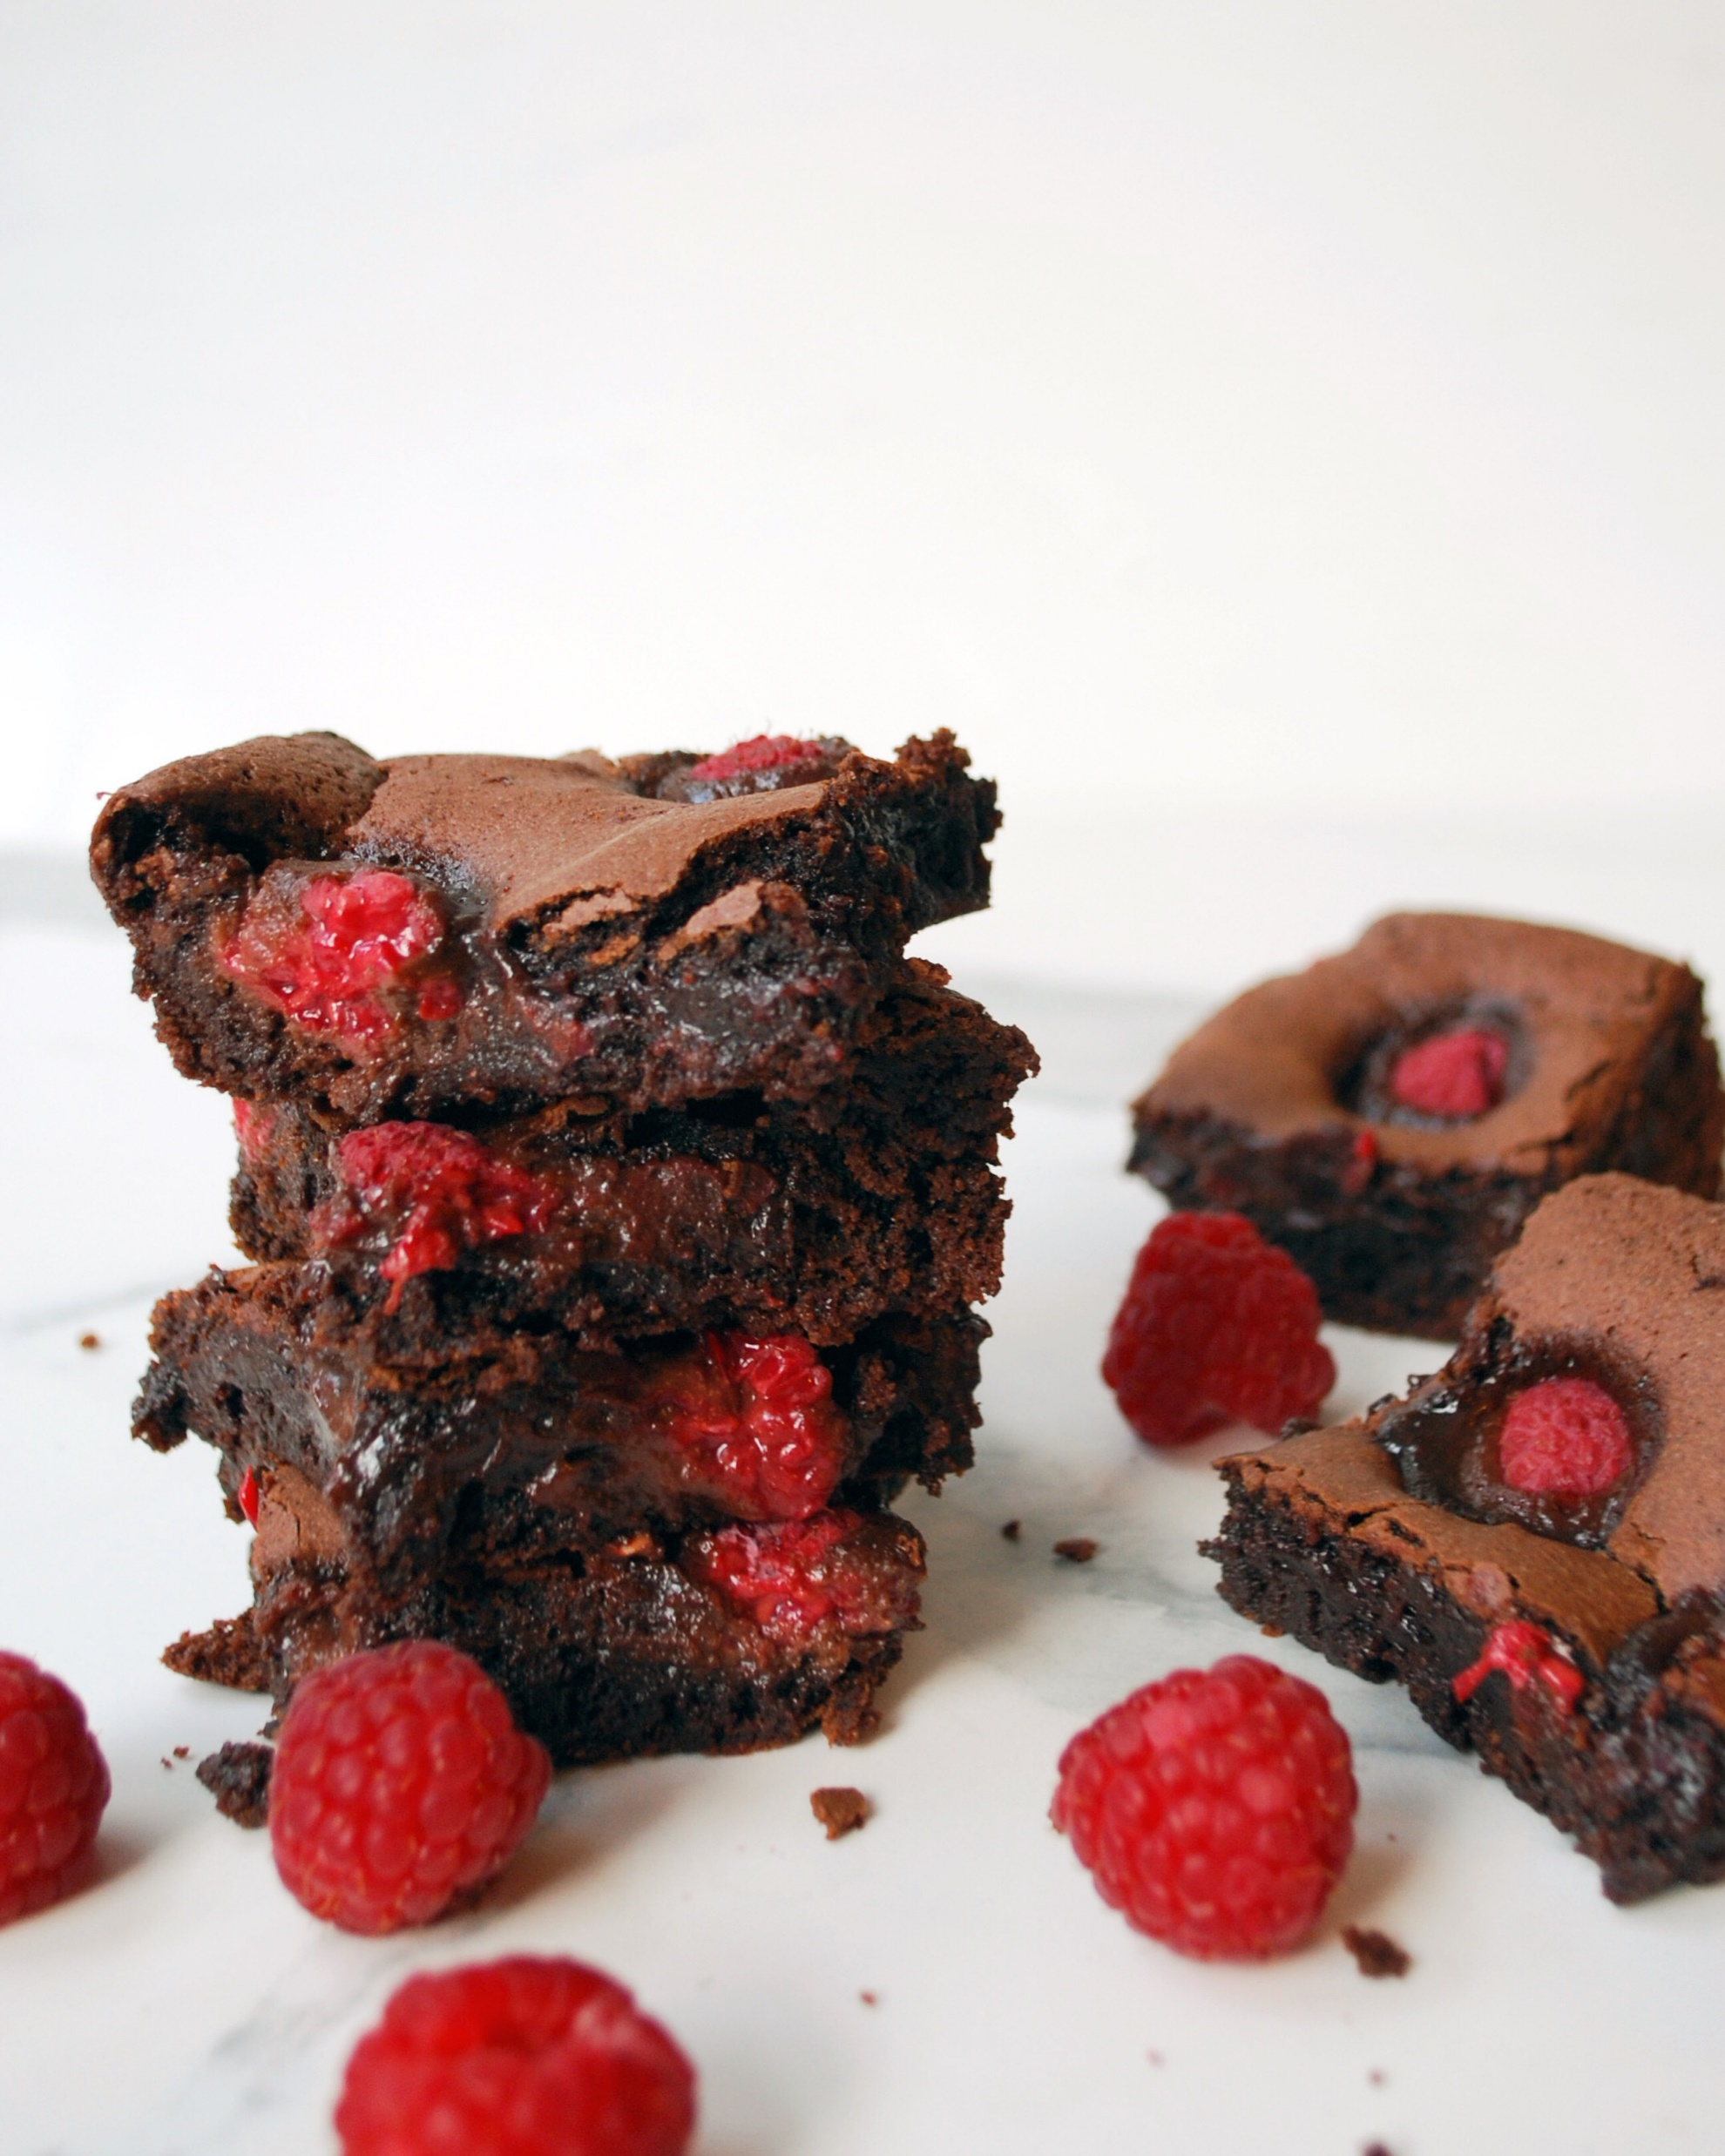
Bake the World a Better Place
Monday 13th May – Friday 18th May 2024
Bake The World a Better Place is a time to take a break, eat some cake and connect with your peers and colleagues during Mental Health Awareness. We know life is busy and can be difficult. Finding time for ourselves and to talk to those we work with can be hard to fit in.
We are encouraging you to organise a cake-related event to raise awareness of how ABS can support you and your teams whilst fundraising to support our Mental Health and Wellbeing Support Services.
Feeling stuck? Why don’t you try:
Design your own recipe competition – get creative and ask your team to invent their own recipes, prizes for originality!
Around the World in Cake – find unique recipes from around the world to theme your baking .
Healthy cakes - theme your event around healthy cake recipes like granola bars or fruit cakes.
Not-cake bake – don’t fancy cake? Have a sandwich sale, make your own pie, or design a quiche.
Cake or biscuit decorating competition or just simply come together to get creative.
C
Collecting your donations
Just Giving
Just Giving is a simple and familiar way for people to donate to your event.
You can set up a page quickly, following their steps and making sure you choose ‘Architects Benevolent Society’ as your chosen charity and join our ABS Bake the World a Better Place campaign page!
If you need any support, get in touch with us at events@absnet.org.uk
Your donation makes a huge difference.
£20 could go towards an annual student membership of AUK (actual cost £30 )
£50 could go towards one month’s running cost for email support (actual cost £77.11)
£100 could cover the cost of one hour of therapy for someone struggling with their mental health.

Slide 2
Bake the World a Better Place
Monday 13th May – Friday 18th May 2024
Bake The World a Better Place is a time to take a break, eat some cake and connect with your peers and colleagues during Mental Health Awareness Week.
Last year, your bake sales, coffee mornings and baking competitions raised an incredible £4000 for the ABS Support Services and gave teams across the country the space to talk about mental health and wellbeing – join us this year!
Feeling stuck? Why don’t you try:
Design your own recipe competition – get creative and ask your team to invent their own recipes, prizes for originality!
Not-cake bake – don’t fancy cake? Have a sandwich sale, make your own pie, or design a quiche.
Healthy cakes - theme your event around healthy cake recipes like granola bars or fruit cakes.
Not-cake bake – don’t fancy cake? Have a sandwich sale, make your own pie, or design a quiche.
Around the World in Cake – find unique recipes from around the world to theme your baking .
Your donation makes a huge difference.
£20 could go towards an annual student membership of AUK (actual cost £30 )
£50 could go towards one month’s running cost for email support (actual cost £77.11)
£100 could cover the cost of one hour of therapy for someone struggling with their mental health.
C
Collecting your donations via Just Giving
Just Giving is a simple and familiar way for people to donate to your event.
You can set up a page quickly, following their steps and making sure you choose ‘Architects Benevolent Society’ as your chosen charity and join our ABS Bake the World a Better Place campaign page!
If you need any support, get in touch with us at events@absnet.org.uk

